Slide 1

Advancing the state of infra-as-code with BICEP

Slide 2

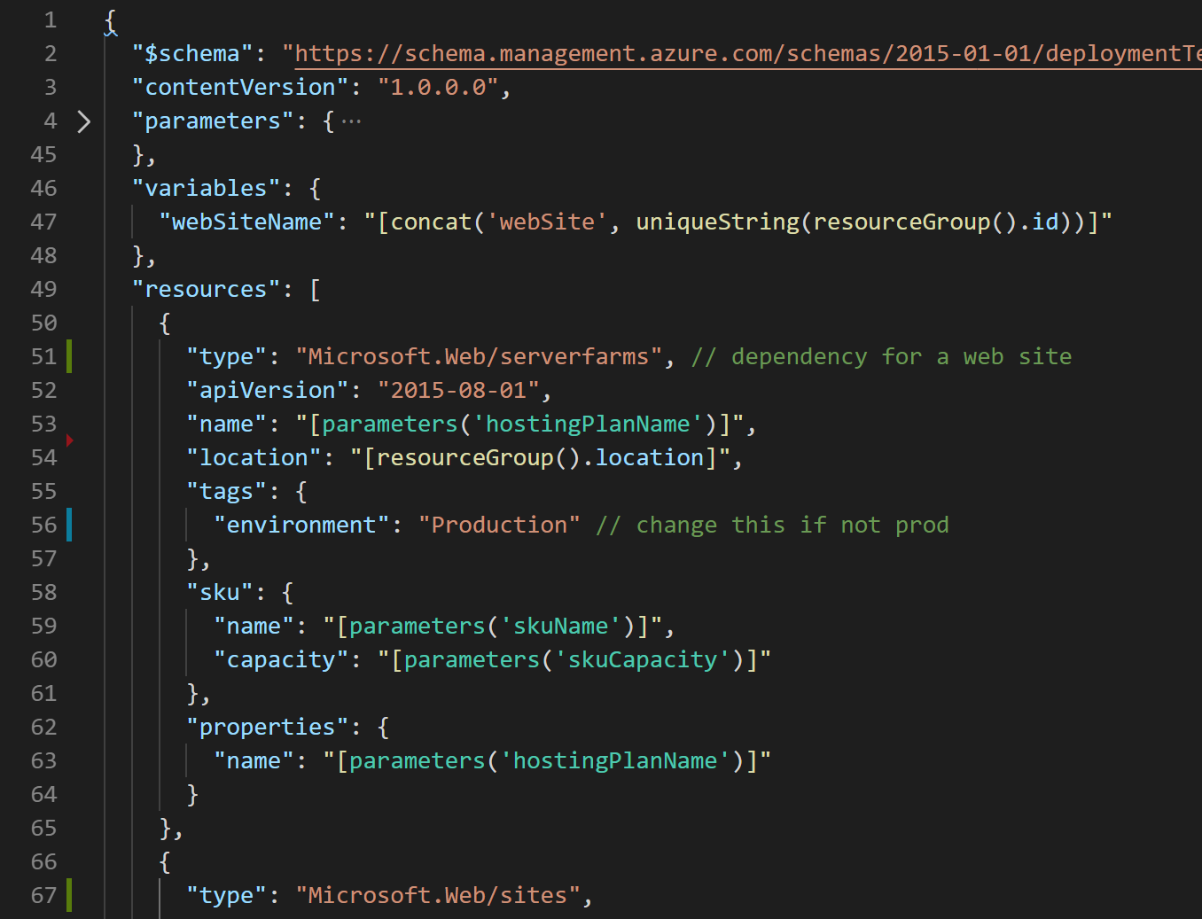




What are ARM Templates?
Declarative files for creating Azure resources in a reliable, repeatable and auditable way.
Infrastructure as Code
Define Azure resources using text files.
Declarative Syntax
Declare how the resources should be and Azure Resource Manager “makes it so”.
JSON
ARM Templates are JSON format text files. Edit them in Visual Studio Code (or other text editors). Version control them.
Meta-Language
Contains some programming language constructs such as functions and loops.
➔
https://docs.microsoft.com/en-us/azure/templates/
Notes:
Need a slide here on other “Deployment” types like terraform and how they compare. Ie. logic to perform ARM puts it handled on client slide vs server side. No validate/preflight.

Slide 3
What is Bicep (ARM Template vNext)?
Bicep Language
An open source Domain Specific Language (DSL) with a simple and modular syntax that transpiles into an ARM Template
bicep build
ARM Templates
Why ‘Bicep’
az deployment group create
Azure Resource Manager
We want customers experiencing Azure for the first time or using Azure as their primary cloud to have the best deployment experience. We believe simplifying the existing language will help many of our customers deploy at scale and have a great experience on Azure.
Storage
Compute
Network
Identity
…
ARC
K8s
GitHub
…
+250 RPs
3rd party extensibility
Learn more: aka.ms/Bicep
Notes:
1. As easy to read as it is to write: Config is priority over code. Easy transition for PowerShell users and DevOps engineers. Ease of learning is priority over ease of use.
2. Transparent Abstraction: Simplify as much as possible without abstracting the platform in any way. Day Zero support will continue.
3. Imperative constructs for a declarative language: Common syntax patterns for looping, conditionals, transformations designed to be use in a declarative way
4. Modularity: Abstract common blocks of configuration into reusable elements. Publish modules to make common resources easy to consume with defaults, then progressively disclose complexity and allow for overrides.
5. Tighten the dev/test loop: Help catch as many errors as possible before I send the template to ARM
Day Zero provider coverage, Policy remediations etc.

Slide 4
Goals
Reduce current pain
Ease of adoption
Compatible with existing templates
Transparent Abstraction: Leverage all the benefits of the platform
Modular: Abstract common blocks of config into reusable elements
Non-Goals
One language to rule them all
General purpose language to meet any need
Invent new technology
Notes:
1. As easy to read as it is to write: Config is priority over code. Easy transition for PowerShell users and DevOps engineers. Ease of learning is priority over ease of use.
2. Transparent Abstraction: Simplify as much as possible without abstracting the platform in any way. Day Zero support will continue.
3. Imperative constructs for a declarative language: Common syntax patterns for looping, conditionals, transformations designed to be use in a declarative way
4. Modularity: Abstract common blocks of configuration into reusable elements. Publish modules to make common resources easy to consume with defaults, then progressively disclose complexity and allow for overrides.
5. Tighten the dev/test loop: Help catch as many errors as possible before I send the template to ARM
Day Zero provider coverage, Policy remediations etc.

Slide 5
Ineresting Questions
Why create a new language instead of using an existing one?
Why not focus your energy on Terraform or other third-party IaC offerings?
Is this ready for production use?​
Is this only for Azure
FAQ'S Reference: https://github.com/Azure/bicep#faq
Notes:
Bicep is more of a revision to the existing ARM template language rather than an entirely new language. While most of the syntax has been changed, the core functionality of ARM templates and the runtime remains the same. With Bicep, Microsoft is revising the syntax of this DSL and moving it into its own .bicep file format. Before going down this path, we closely evaluated using an existing high-level programming language, but ultimately determined that bicep would be easier to learn for our target audience.
2. There is a huge customer base using ARM templates today (80% of all resource created in Azure are done via ARM Templates) because it provides a unique set of capabilities and benefits. We wanted to make the experience for those customers first-class as well, in addition to making it easier to start for Azure focused customers
3. Yes, This is under support plan as well
4. Bicep is a DSL focused on deploying end-to-end solutions in Azure. In practice, that usually means working with some non-Azure APIs which may come in future but for now this is focused on AZURE only.

Slide 6
Bicep Workshop
Workshop available at https://github.com/munishm/bicep-workshop. Use the repo or fork it
Discussions are advised
Break out rooms
Huddle at the end
Feedback is welcome
Notes:
If you want to work together for some challenge, feel free to break out in separate rooms and come back to main meeting.

Slide 7
Resources
Watch the project: https://github.com/azure/bicep
Join or reach out to ARM Deployment Experts DL (armexperts@microsoft.com)
Ignite session - Learn everything about the next generation of ARM Templates

